Slide 1
What’s in your refrigerator, and where did it come from?

Slide 2

Directions
On the next slide (slide 3) click on the different products in the refrigerator to see where they came from.
Continue to click on the product on the subsequent slides and you will return to the main slide (slide 3).
Continue clicking on the next product until you have discovered where all the items came from.

Slide 3
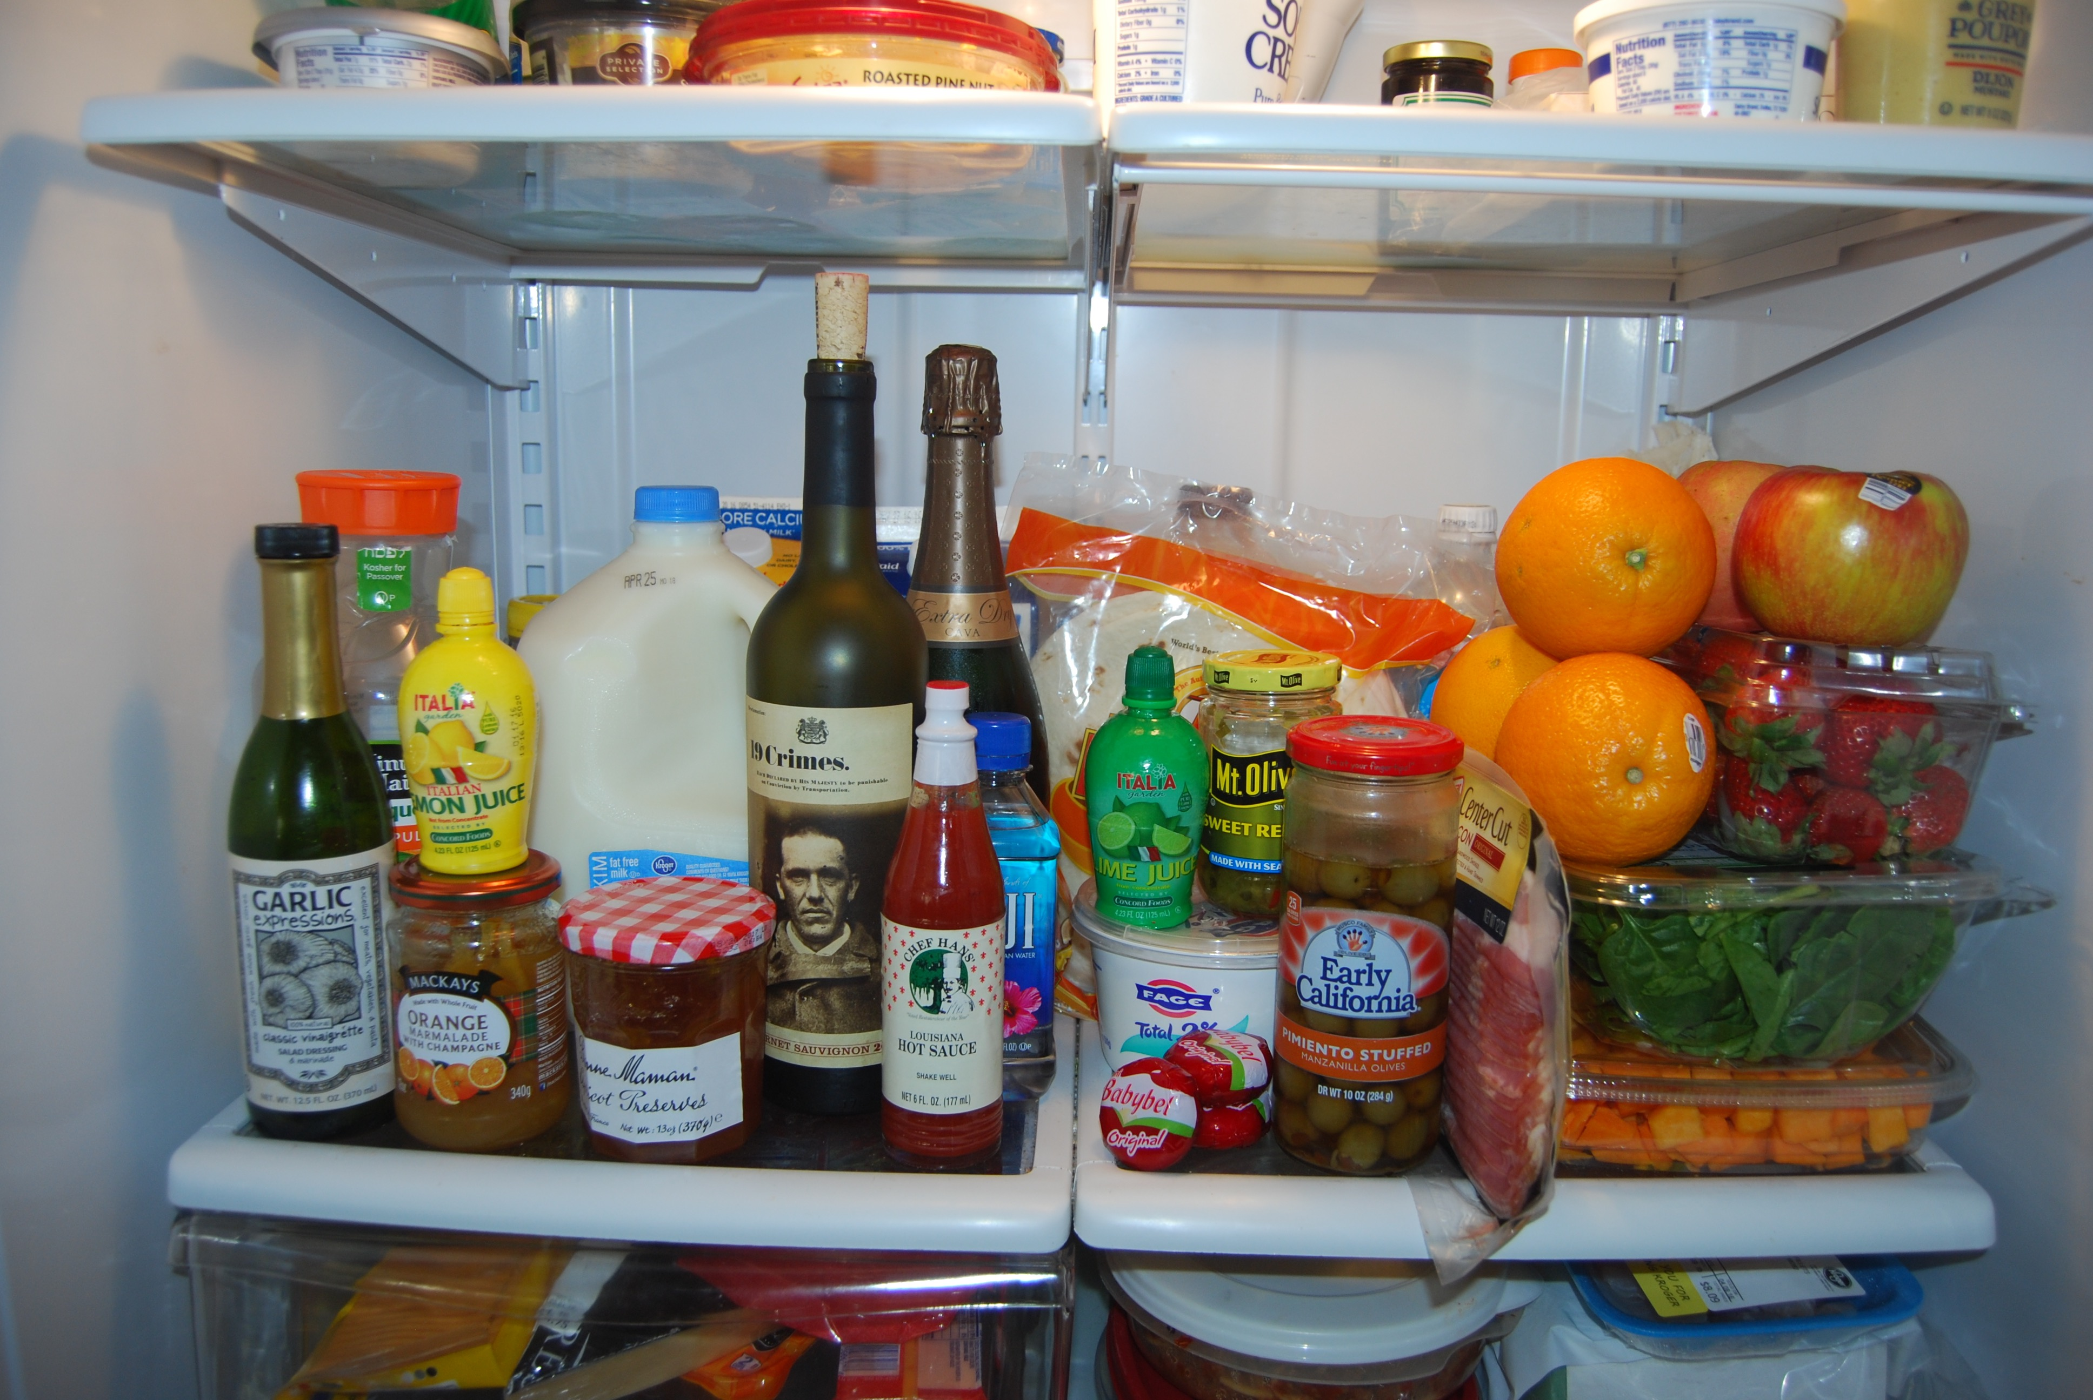
What’s in your refrigerator, and where did it come from?
Australia
California (4)
Fiji
Florida and Brazil
France
Guatemala
Italy
Louisiana
Mexico (2)
New York
North Carolina
Ohio
Scotland
South Dakota
Spain
Tennessee
Texas
Washington
Click on each item below to see where it came from.

Slide 4
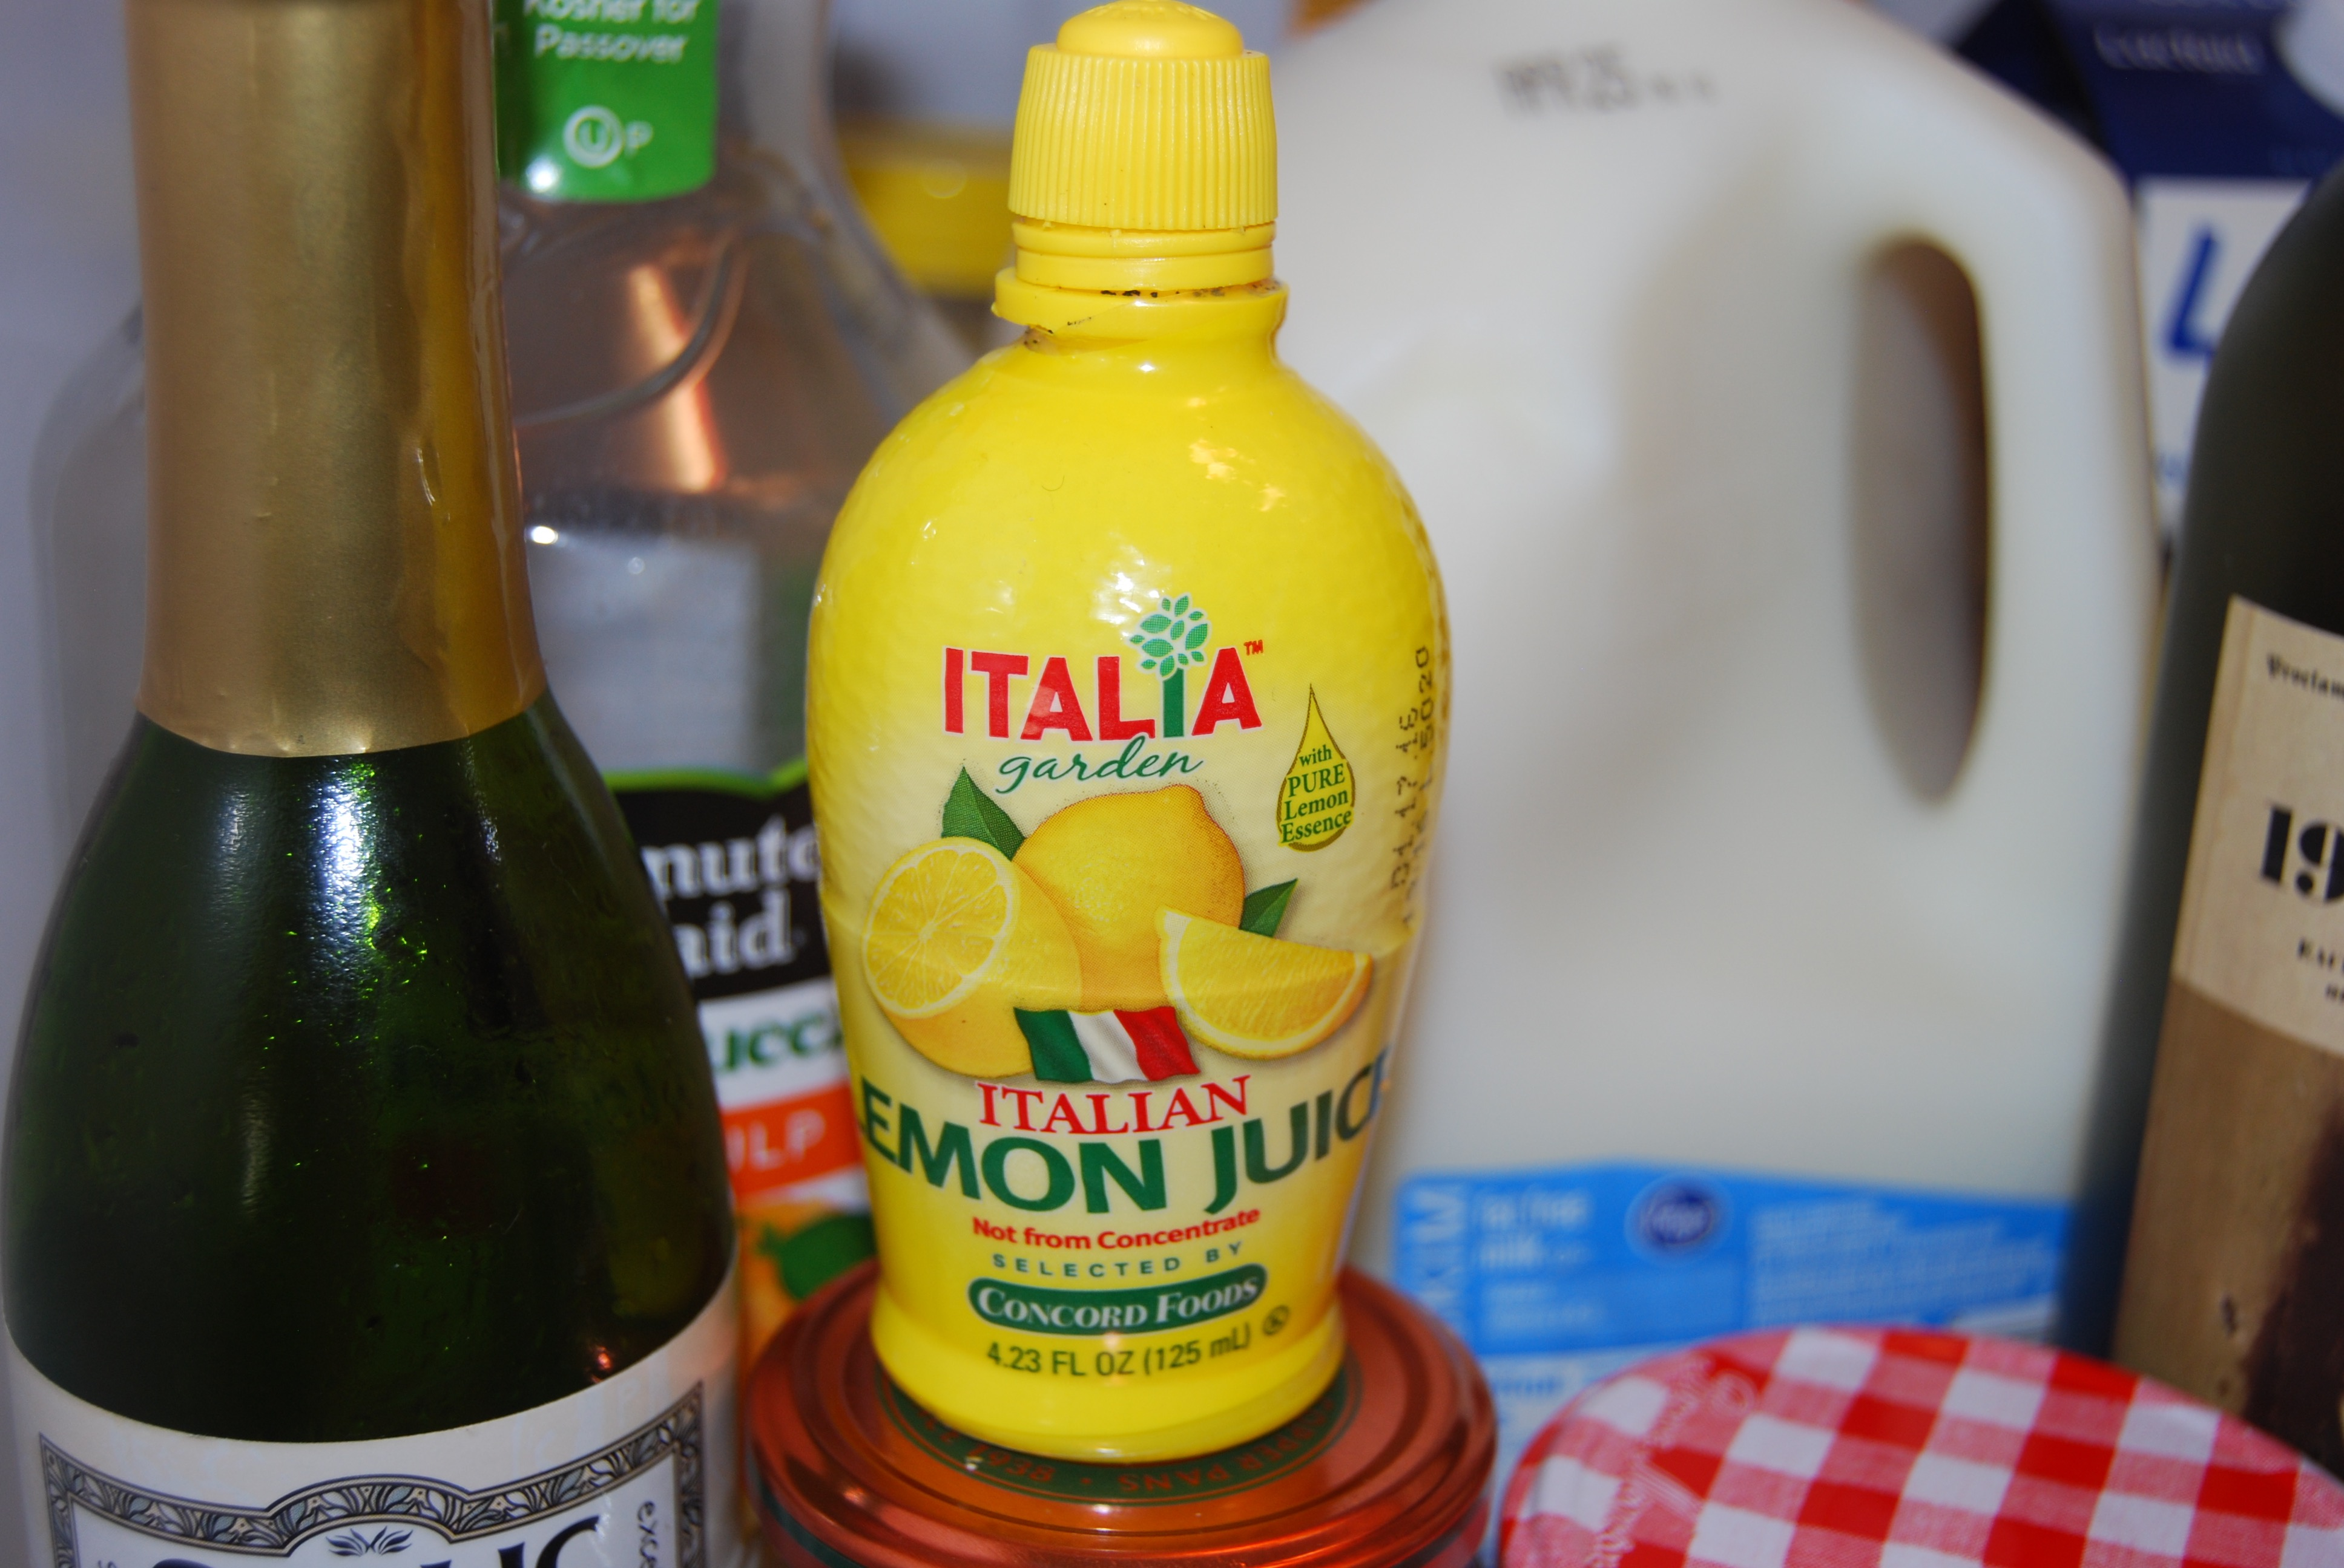

Slide 5
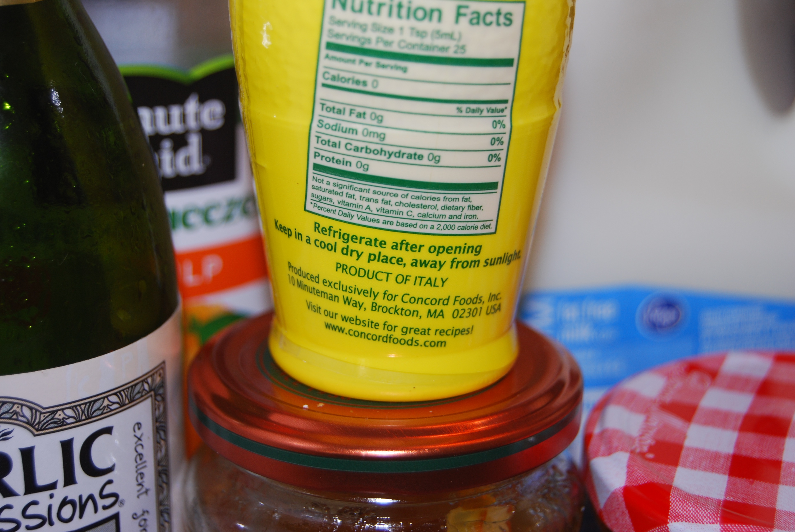

Slide 6


Slide 7
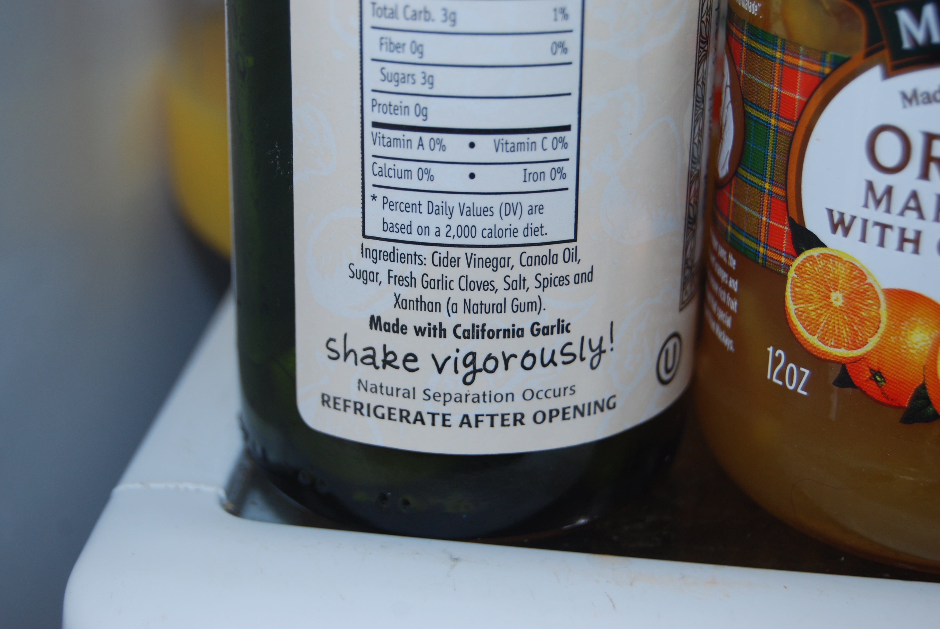


Slide 8
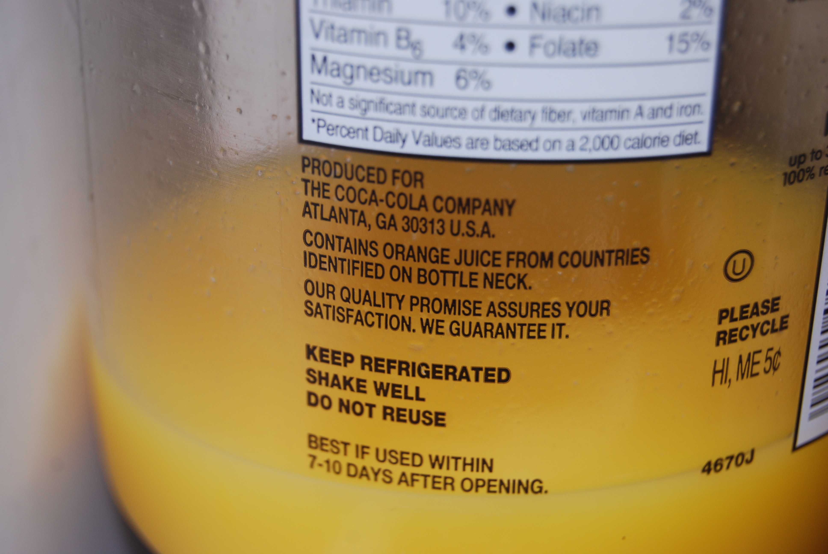

Slide 9
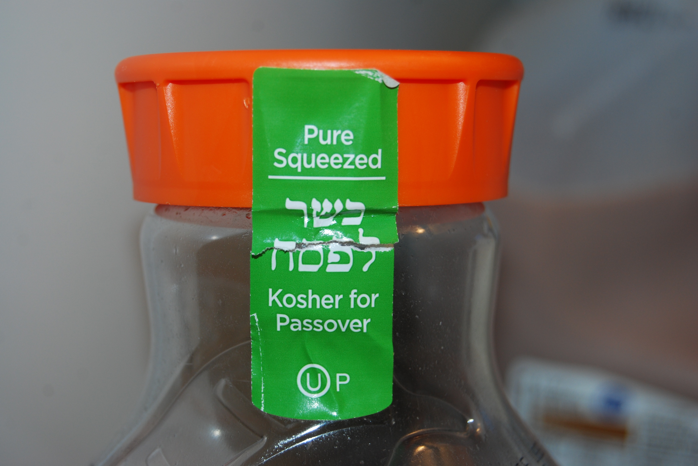

Slide 10
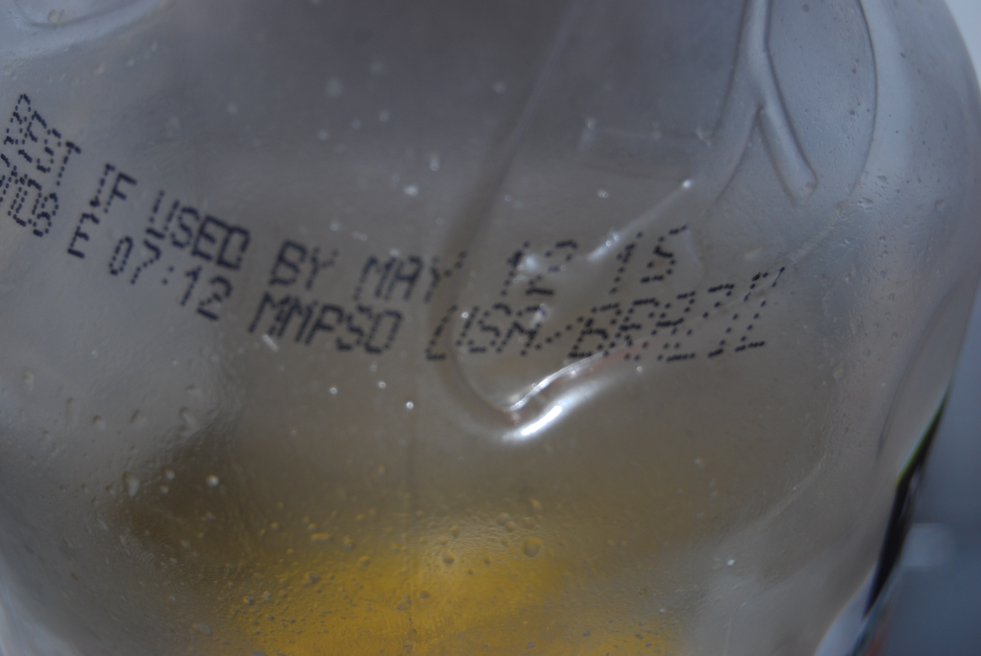

Slide 11
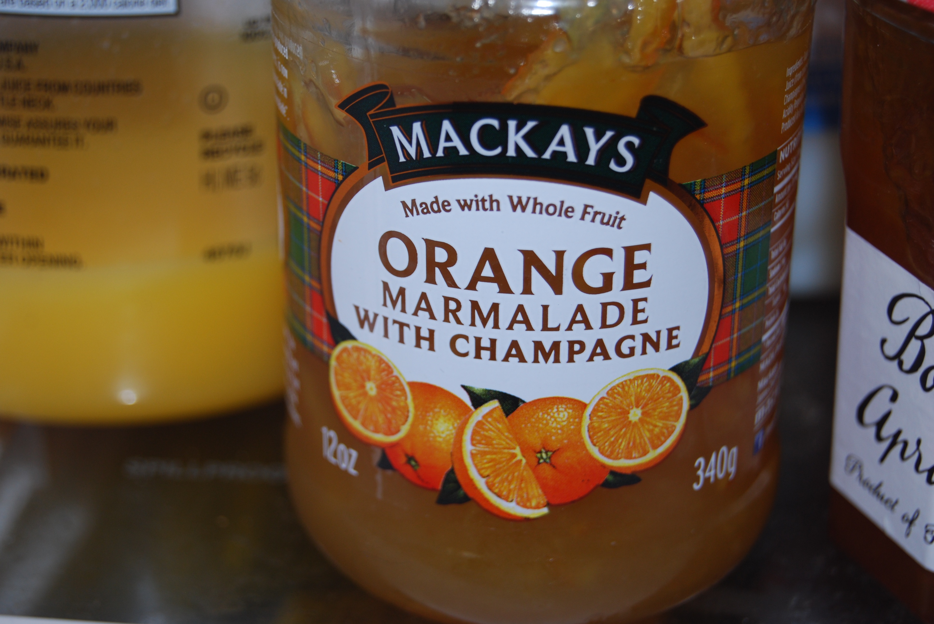

Slide 12
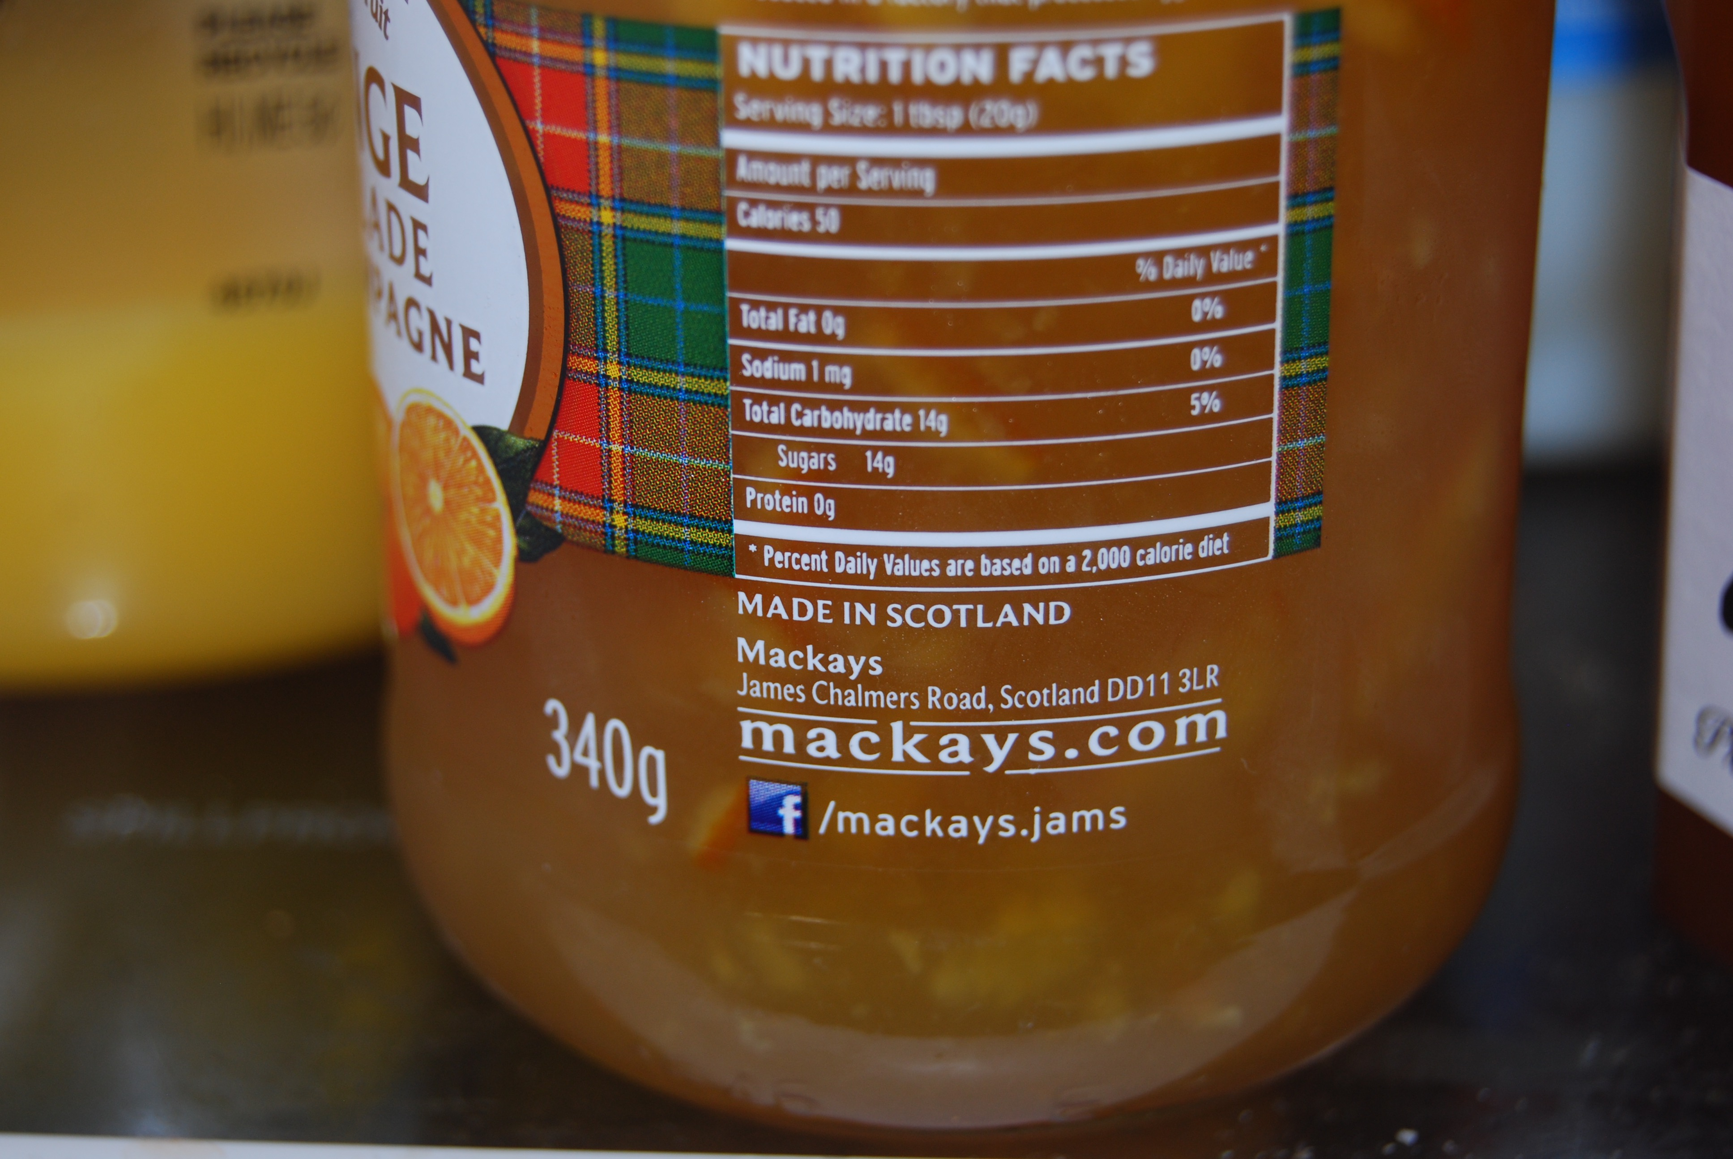

Slide 13
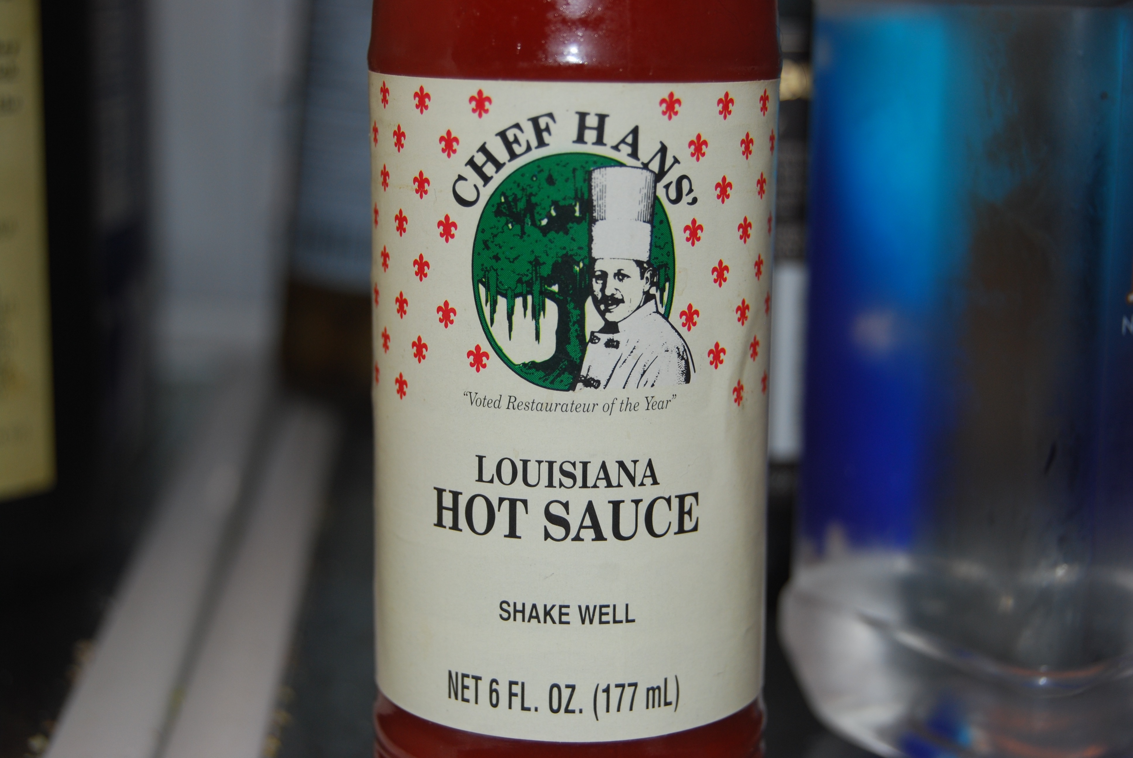

Slide 14
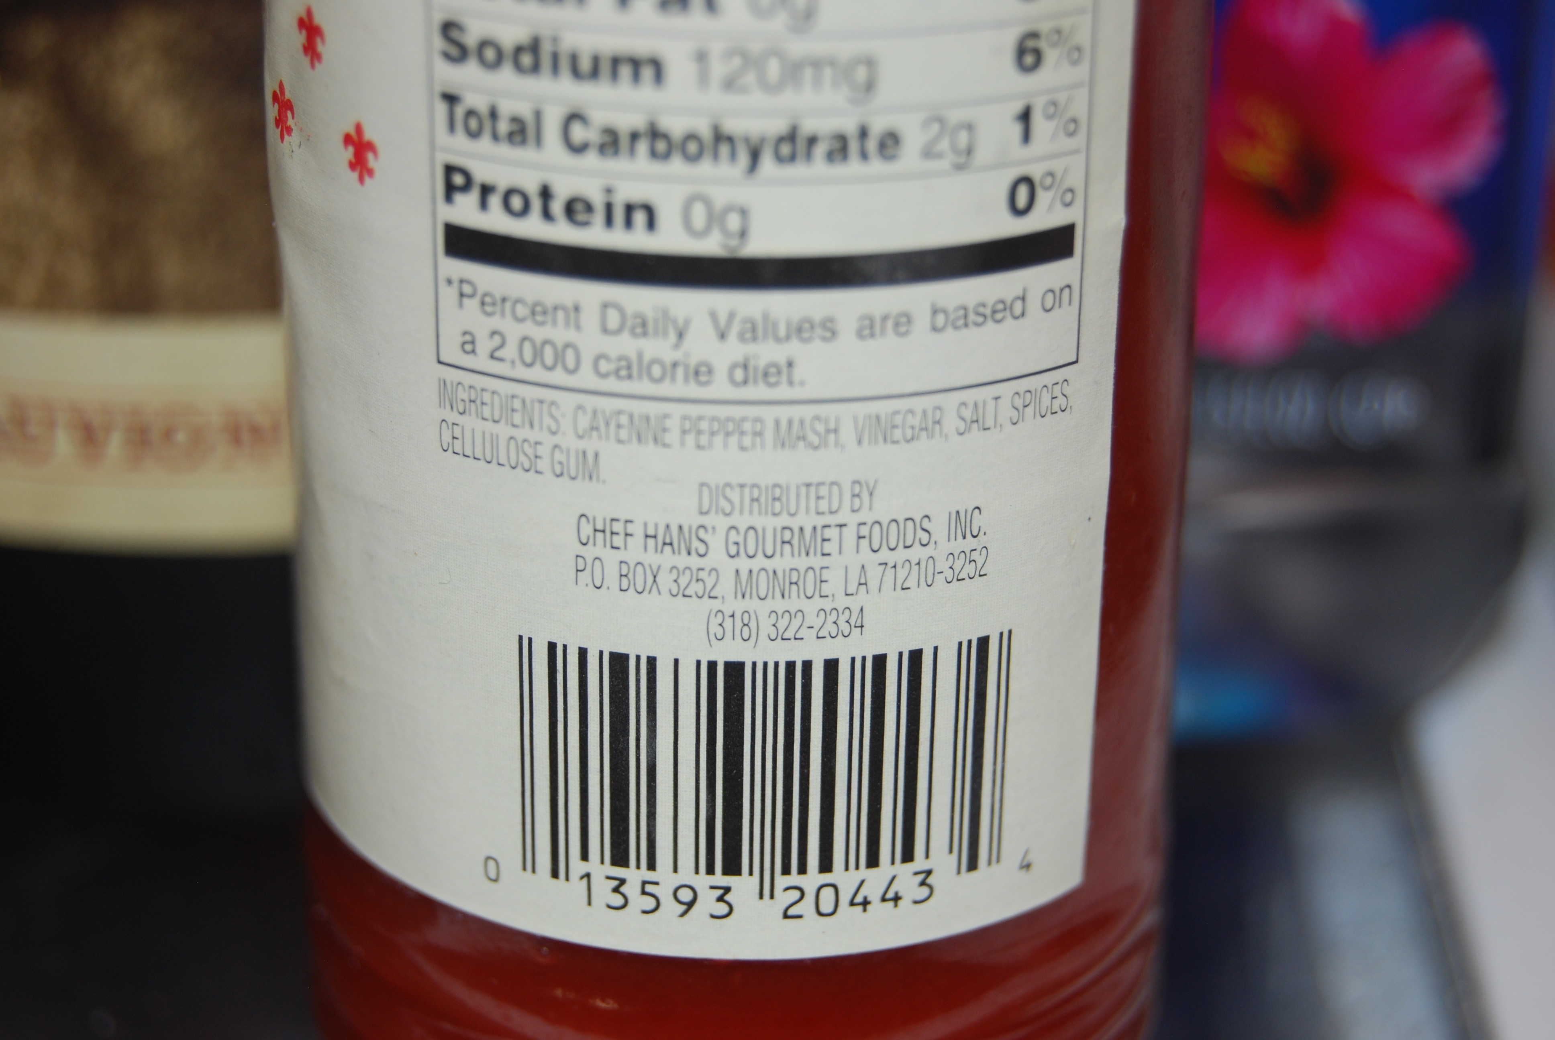

Slide 15


Slide 16
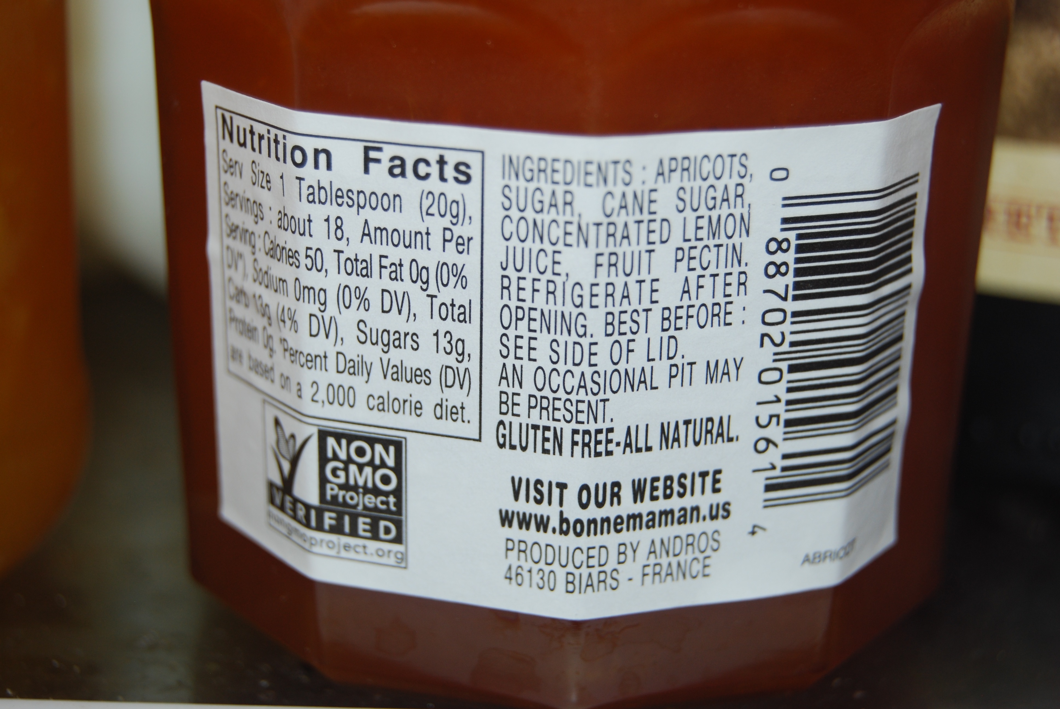

Slide 17
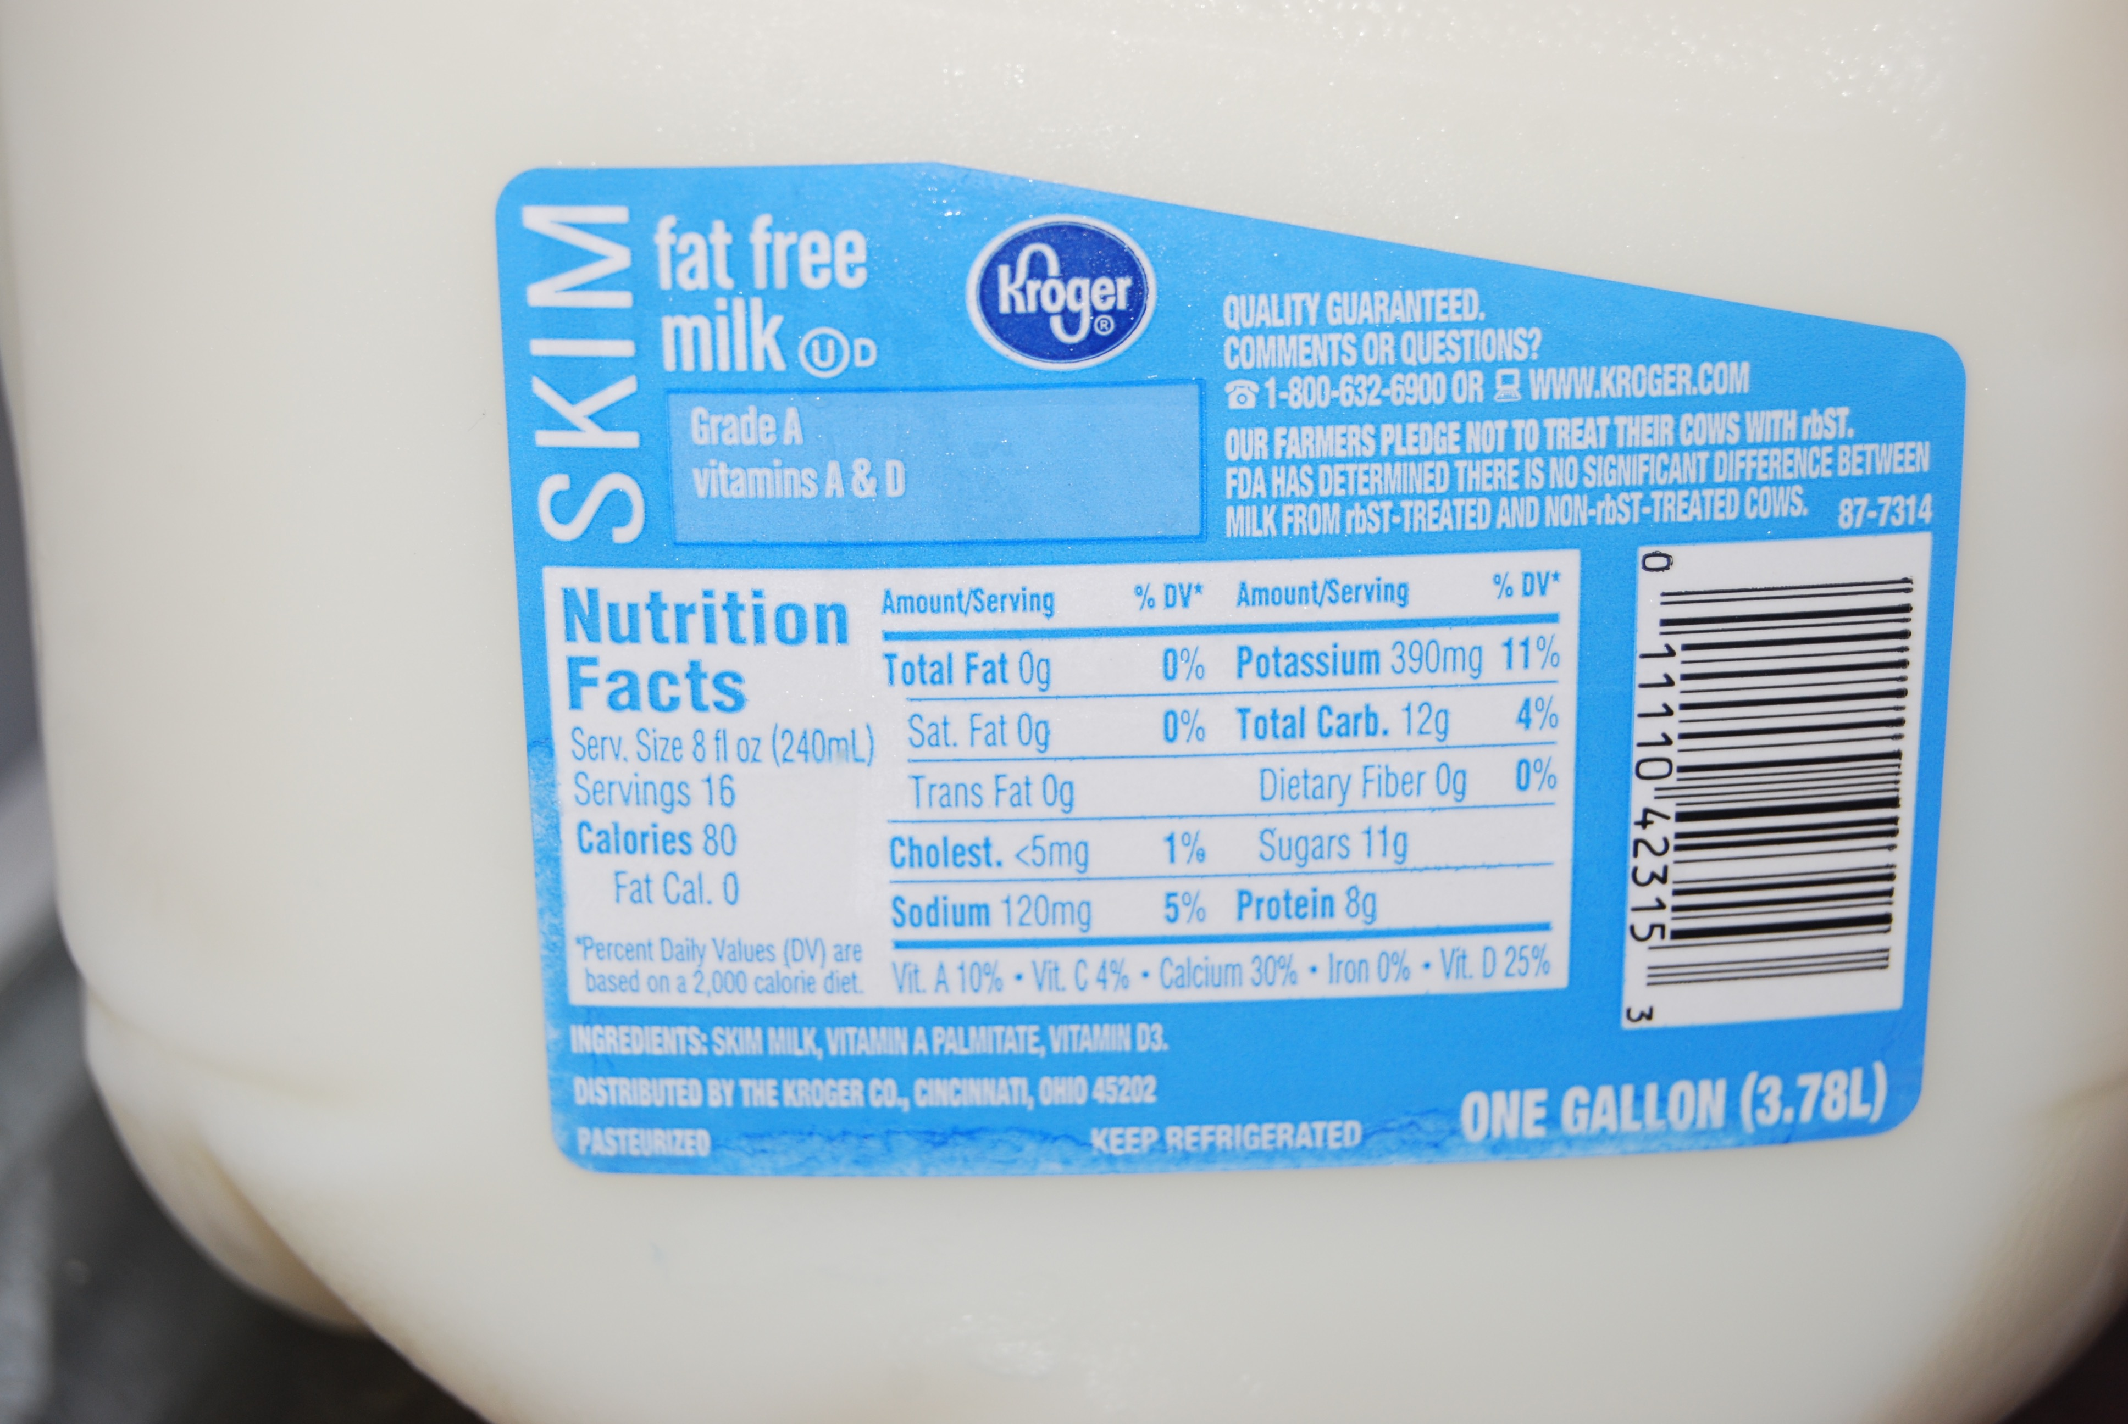

Slide 18
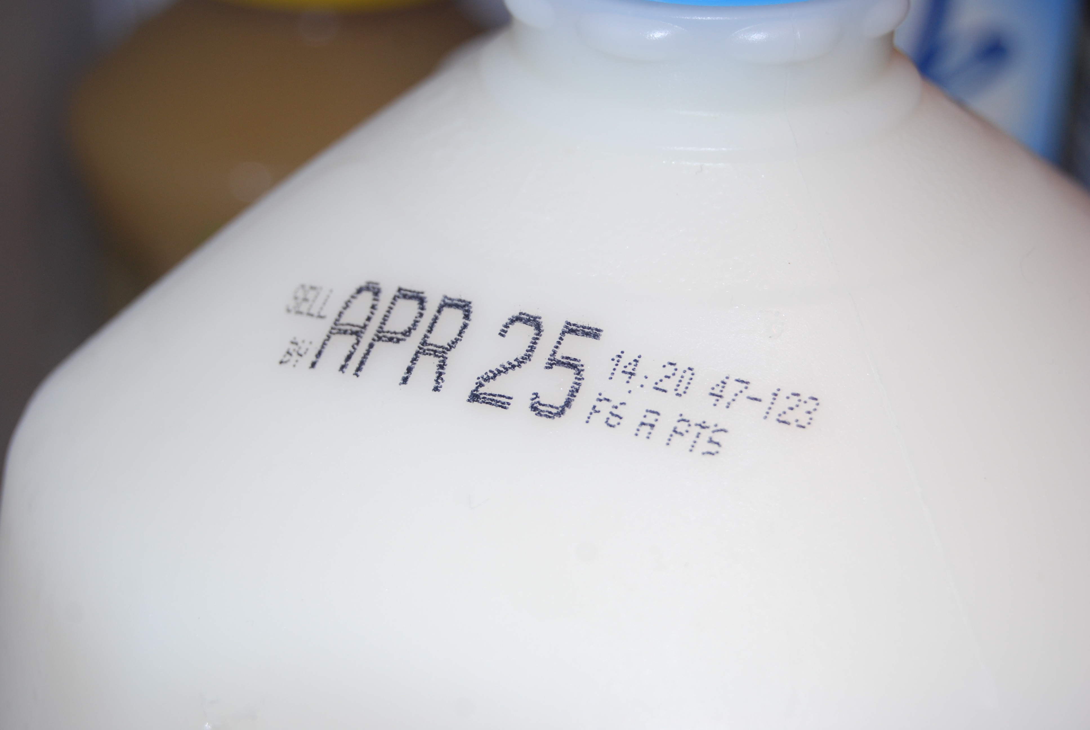

Slide 19
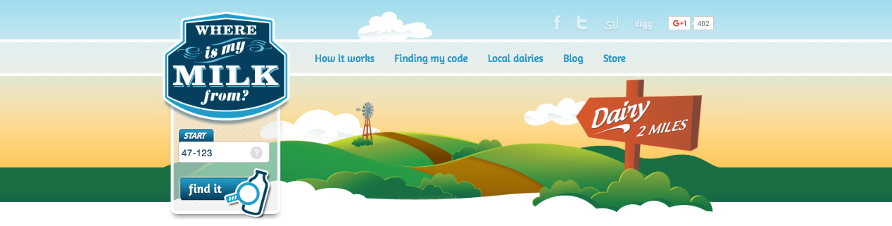
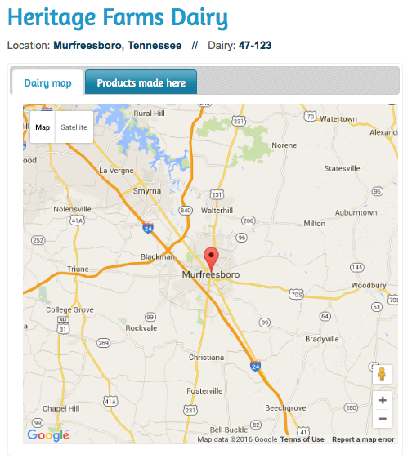
http://whereismymilkfrom.com

Slide 20
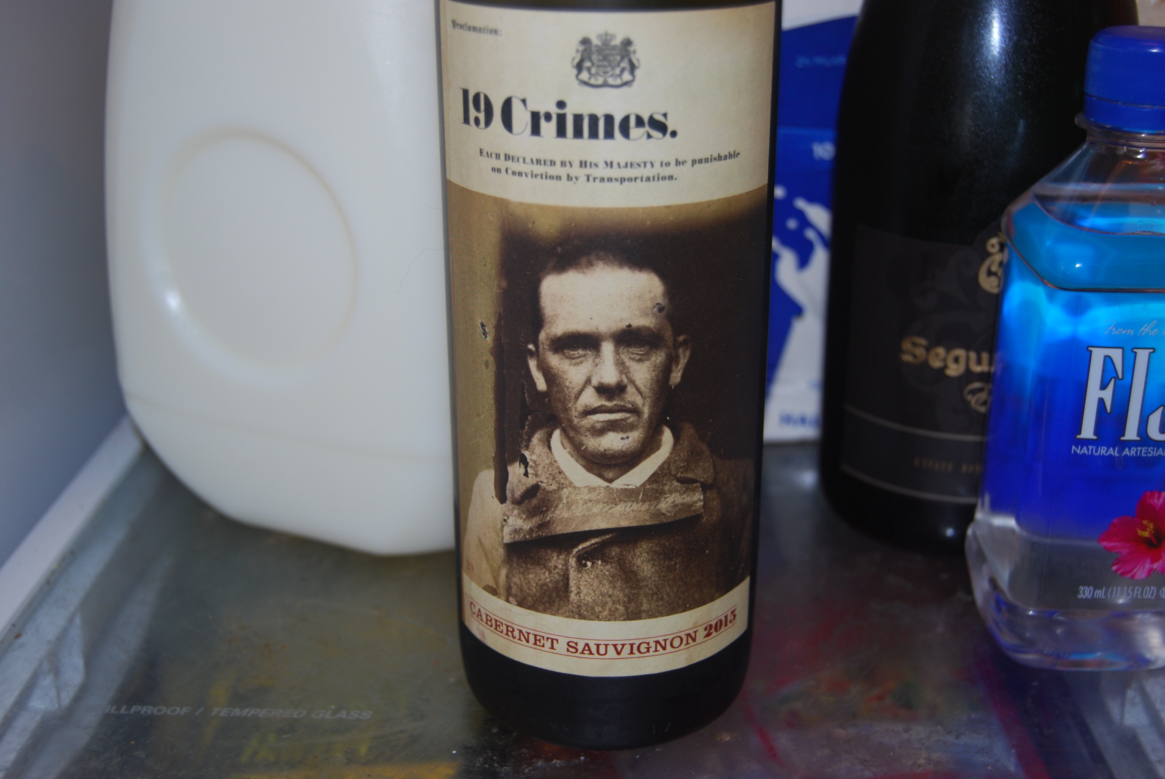
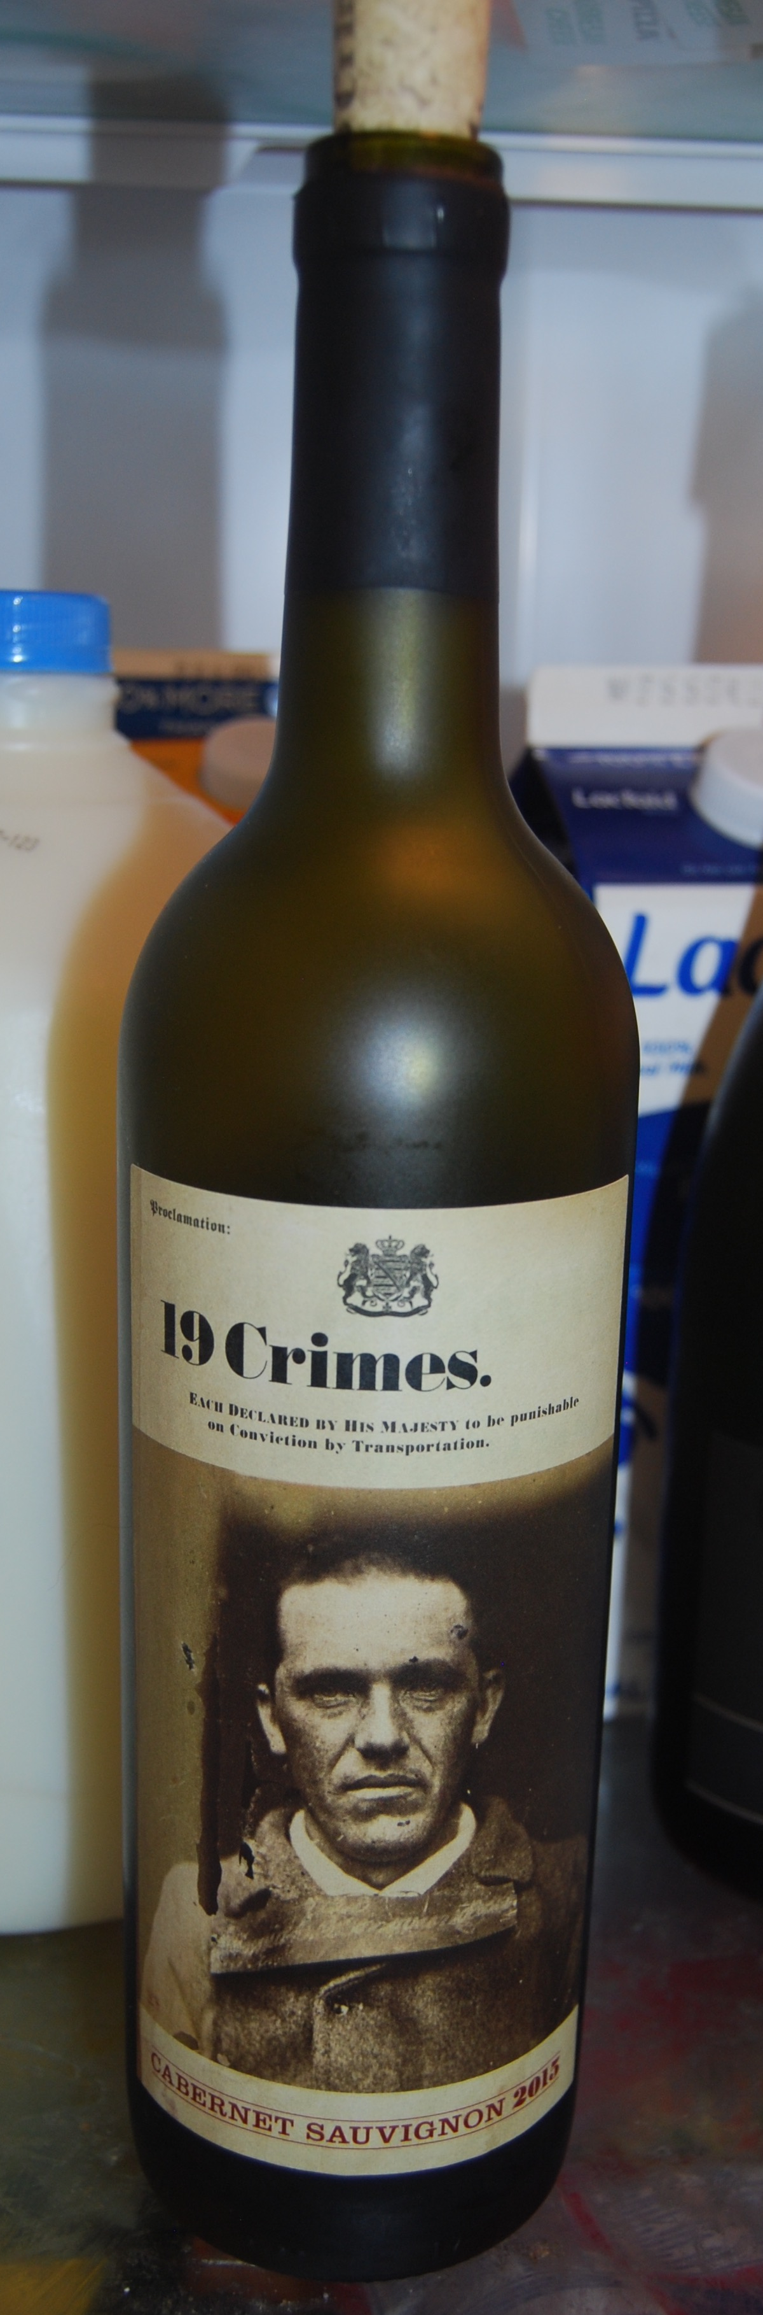

Slide 21
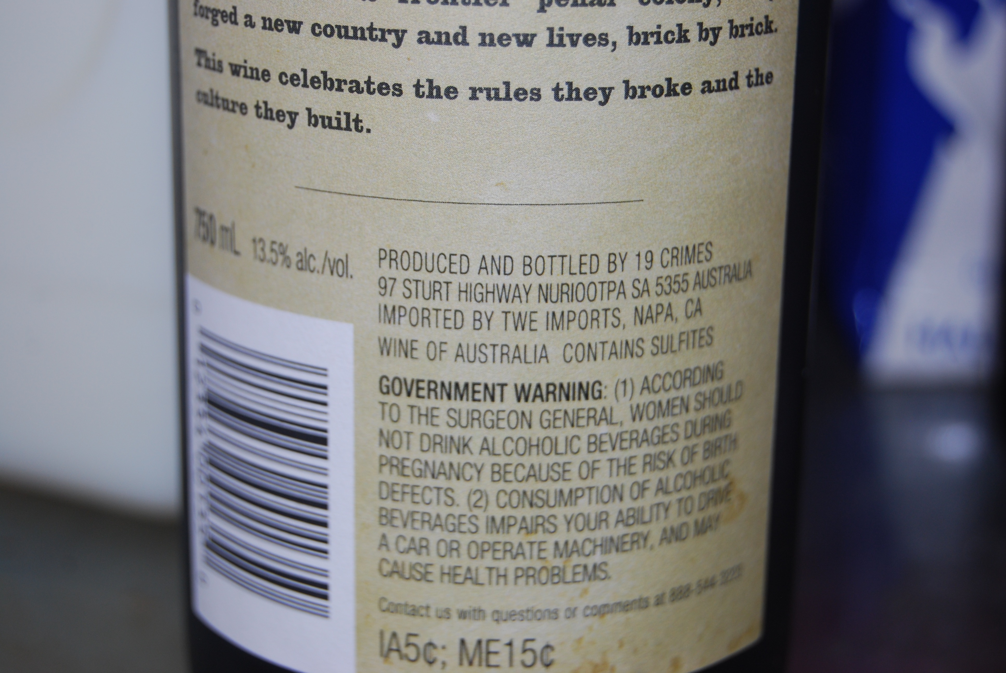

Slide 22
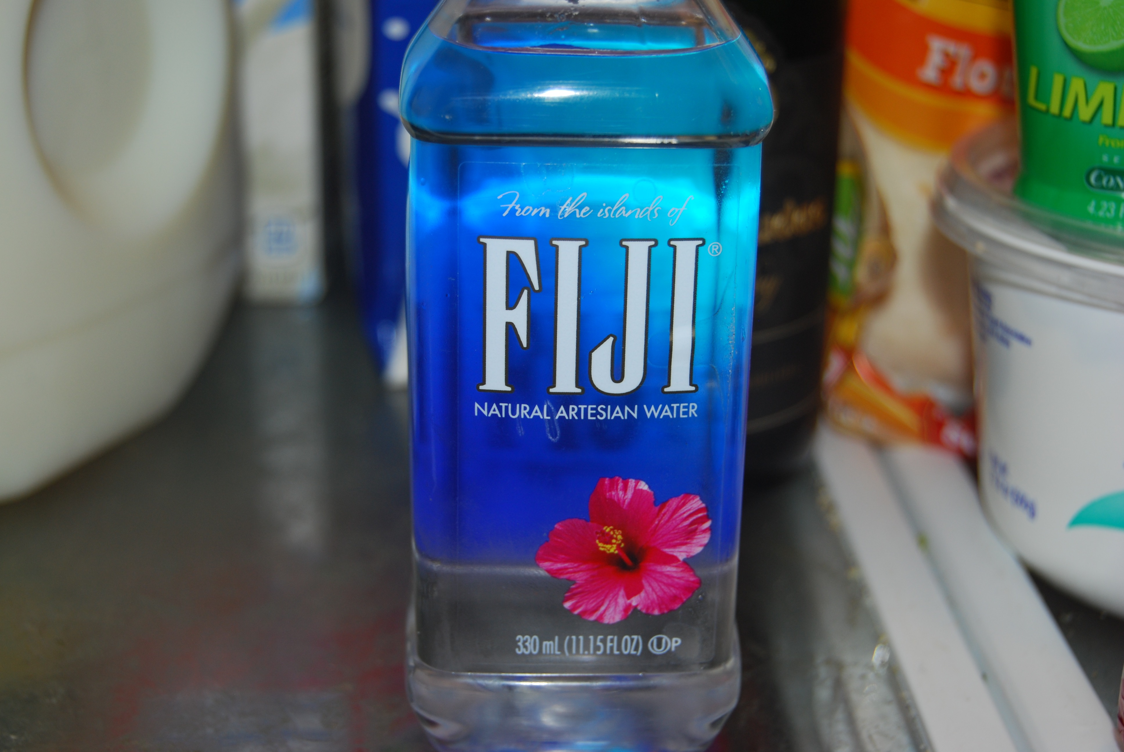
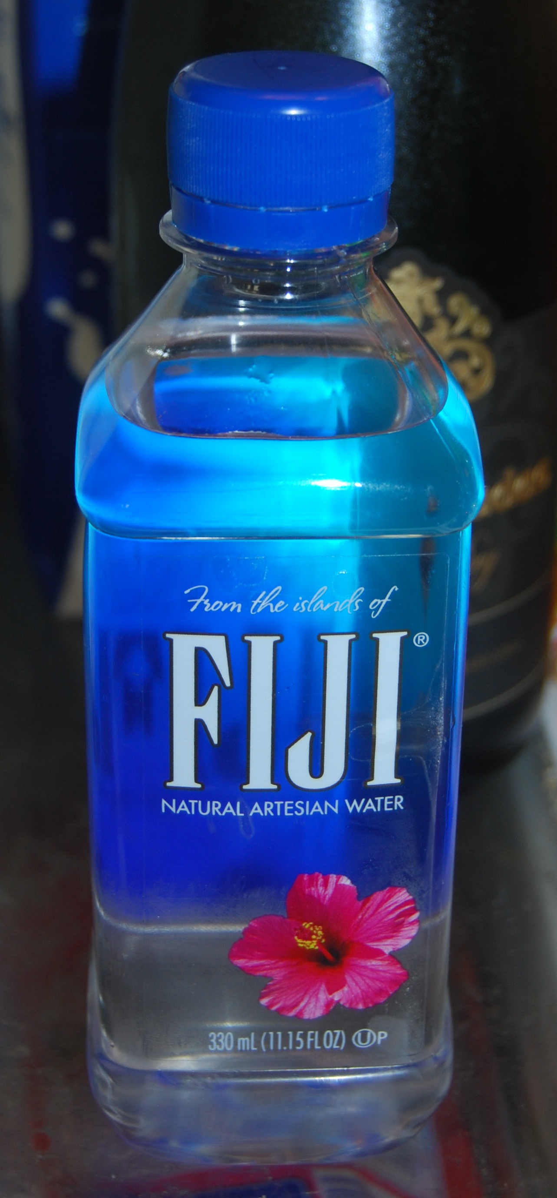

Slide 23
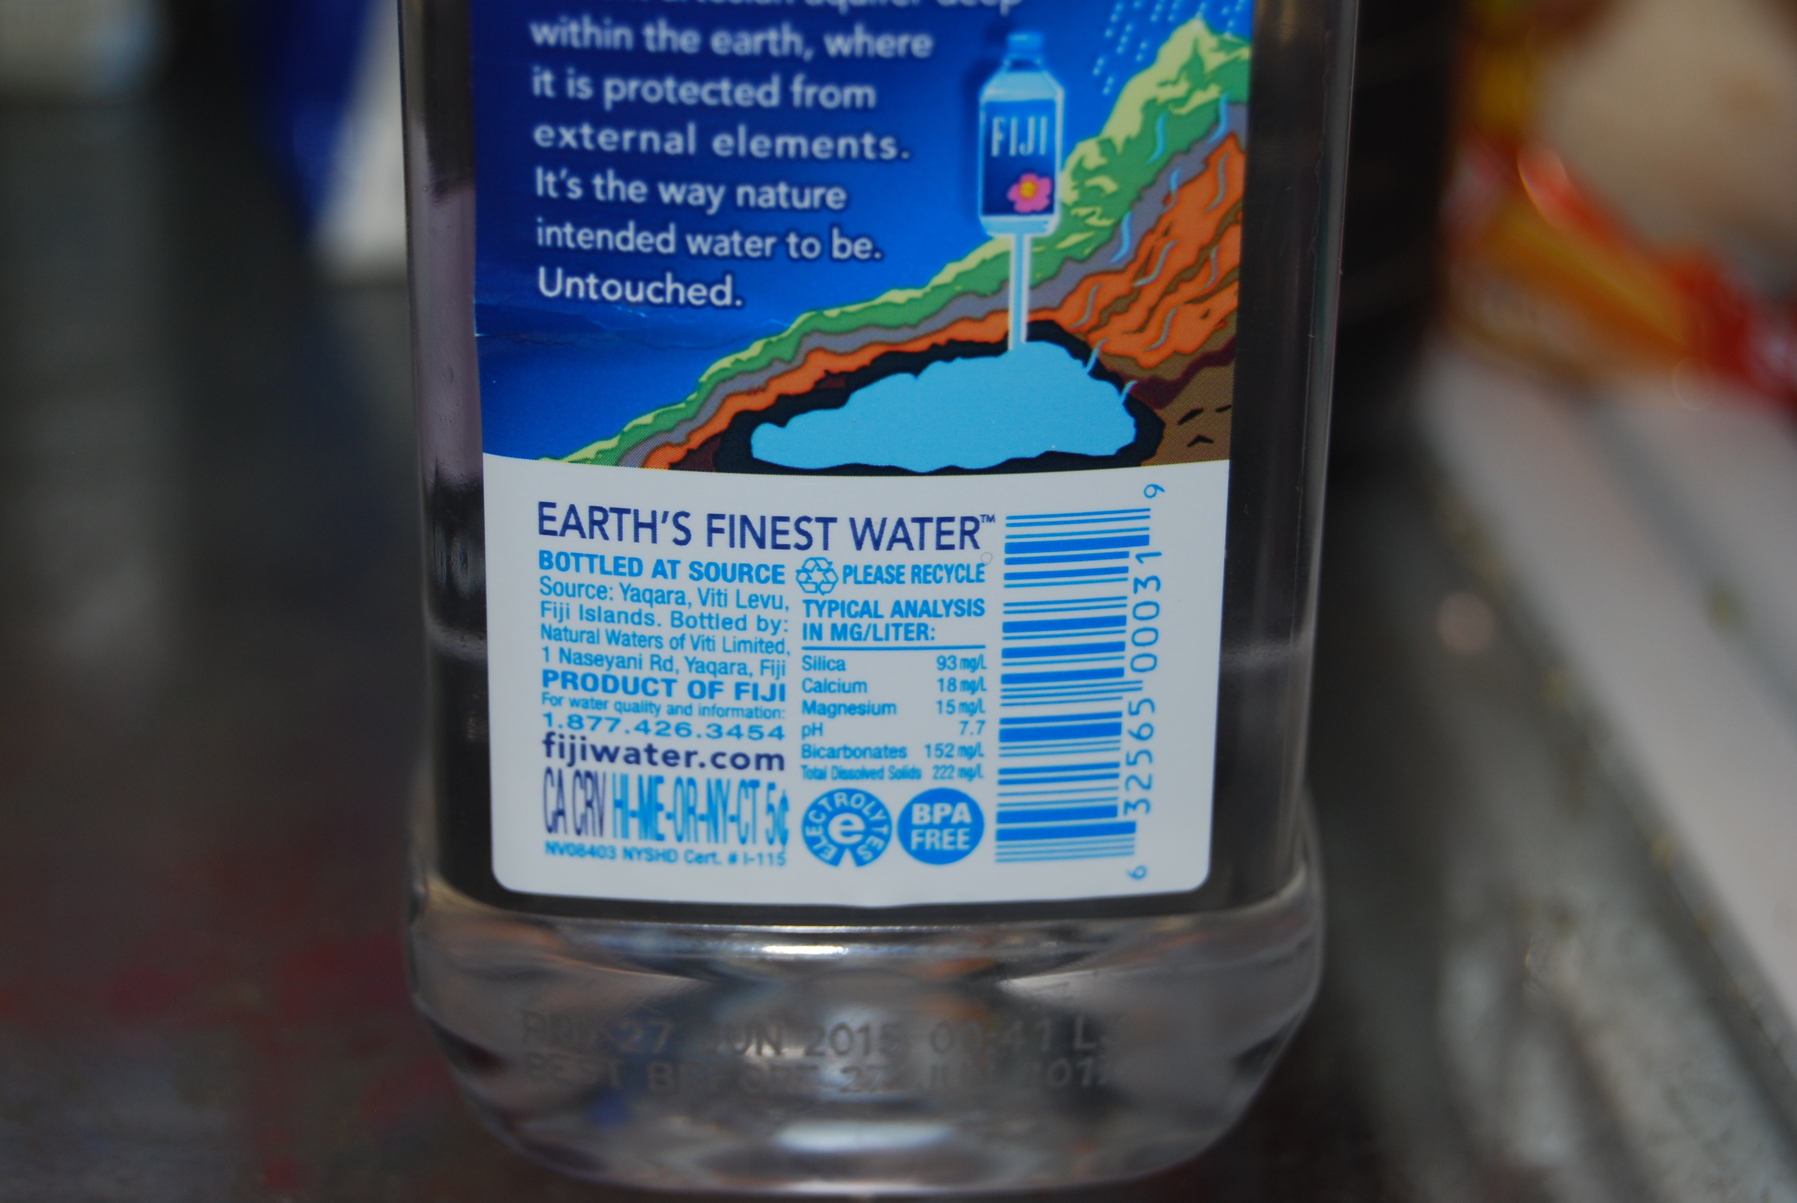

Slide 29
